Slide 1


CSB4403 – Applied Cryptography and Network Security
B.Tech – VII Semester
Dr. S.Sathya Priya
Associate professor
School of Computing Sciences,
Department of Computer Science and Engineering

Slide 2
MODULE 1: COMPUTER SECURITY BASICS
Computer Security Concepts, OSI Security Architecture, Security Attacks, Security Services, Security Mechanisms, Model for Network Security, Classical Encryption techniques- Substitution and Transposition methods, Block Cipher Principles

Slide 3
Cryptographic algorithms and protocols can be grouped into four main areas:
Symmetric encryption
Asymmetric encryption
Data integrity algorithms
Authentication protocols

Slide 4
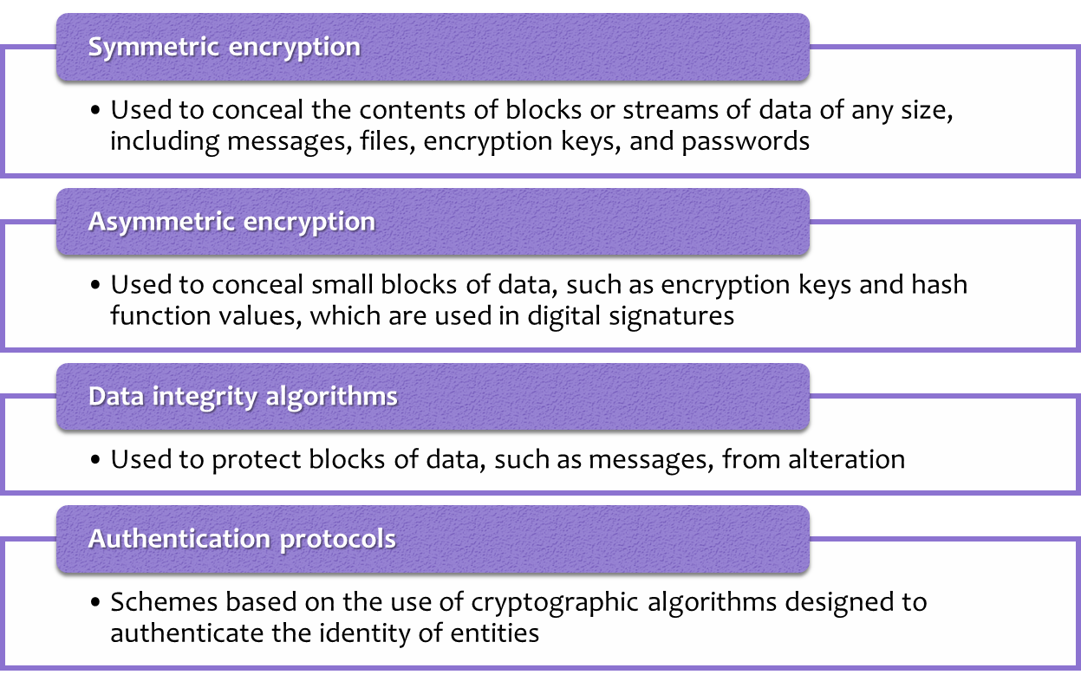

Slide 5
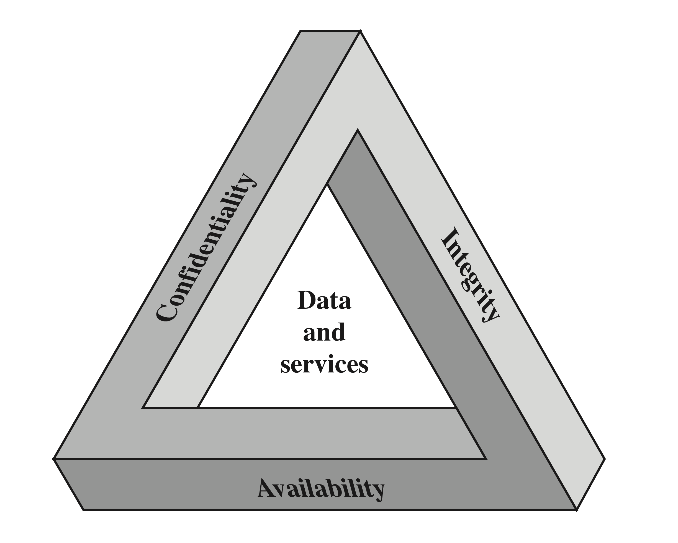
Computer Security Concepts
3 key objectives of Computer
Security:

Slide 6
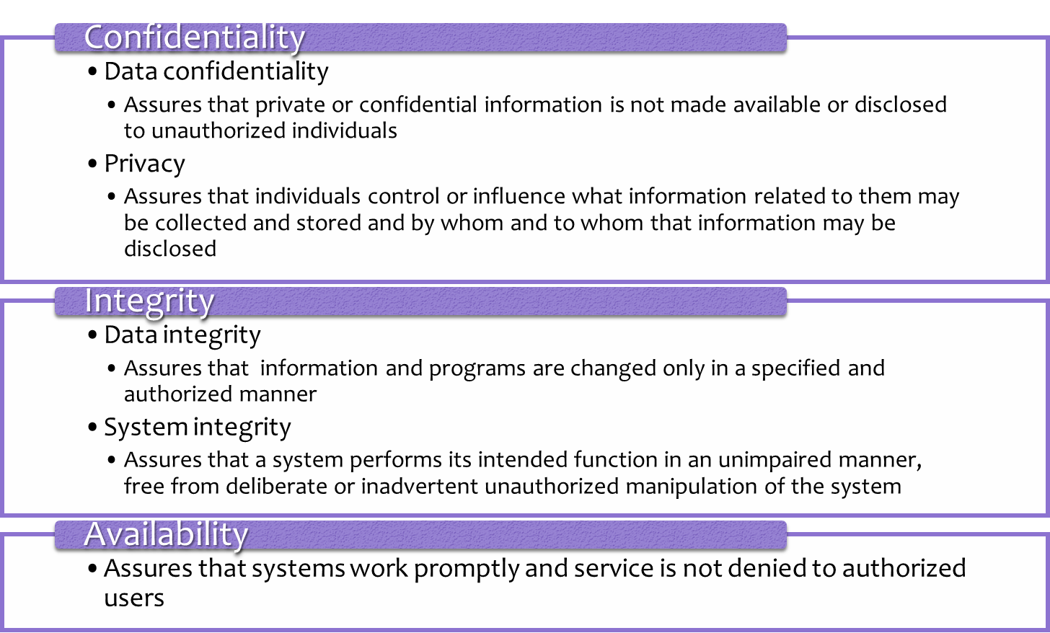

Slide 7
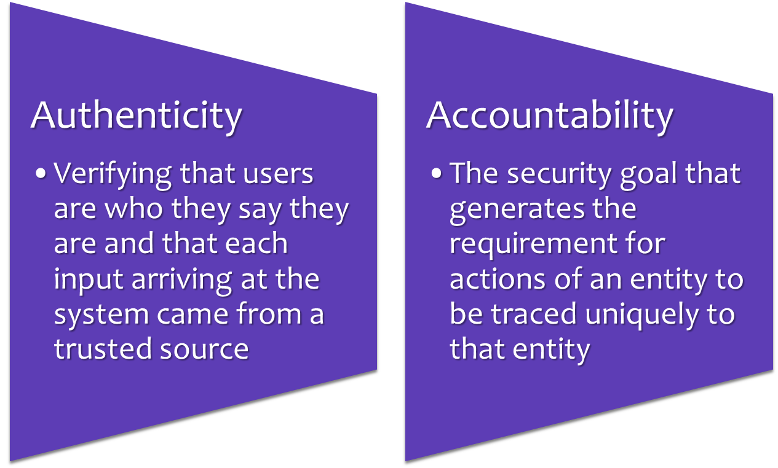
Additional Concepts:

Slide 8
Additional Concepts:
High
The loss could be expected to have a severe or catastrophic adverse effect on organizational operations, organizational assets, or individuals
Moderate
The loss could be expected to have a serious adverse effect on organizational operations, organizational assets, or individuals
Low
The loss could be expected to have a limited adverse effect on organizational operations, organizational assets, or individuals

Slide 9
Challenges of Computer Security
Security is not simple
Potential attacks on the security features need to be considered
Procedures used to provide particular services are often counter-intuitive
It is necessary to decide where to use the various security mechanisms
Requires constant monitoring
Is too often an afterthought
Security mechanisms typically involve more than a particular algorithm or protocol
Security is essentially a battle of wits between a perpetrator and the designer
Little benefit from security investment is perceived until a security failure occurs
Strong security is often viewed as an impediment to efficient and user-friendly operation

Slide 10
OSI Security Architecture
Security attack
Any action that compromises the security of information owned by an organization
Security mechanism
A process (or a device incorporating such a process) that is designed to detect, prevent, or recover from a security attack
Security service
A processing or communication service that enhances the security of the data processing systems and the information transfers of an organization
Intended to counter security attacks, and they make use of one or more security mechanisms to provide the service

Slide 11
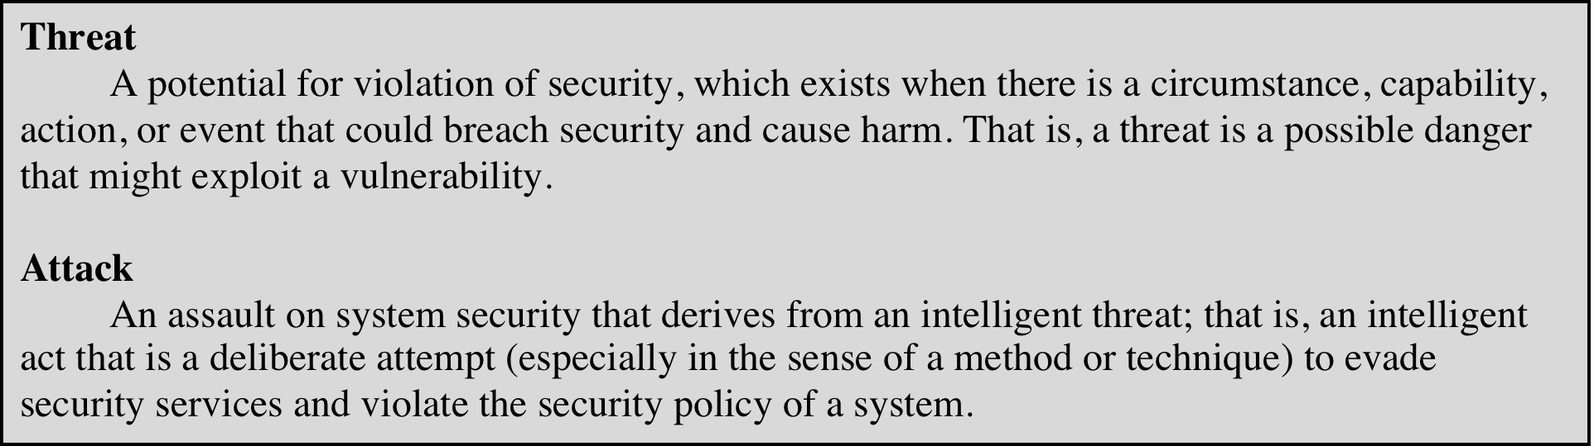
Threats & Attacks

Slide 12
Security Attacks
Active Attacks
Passive Attacks

Slide 13
Security Attacks
A passive attack attempts to learn or make use of information from the system but does not affect system resources
An active attack attempts to alter system resources or affect their operation

Slide 14
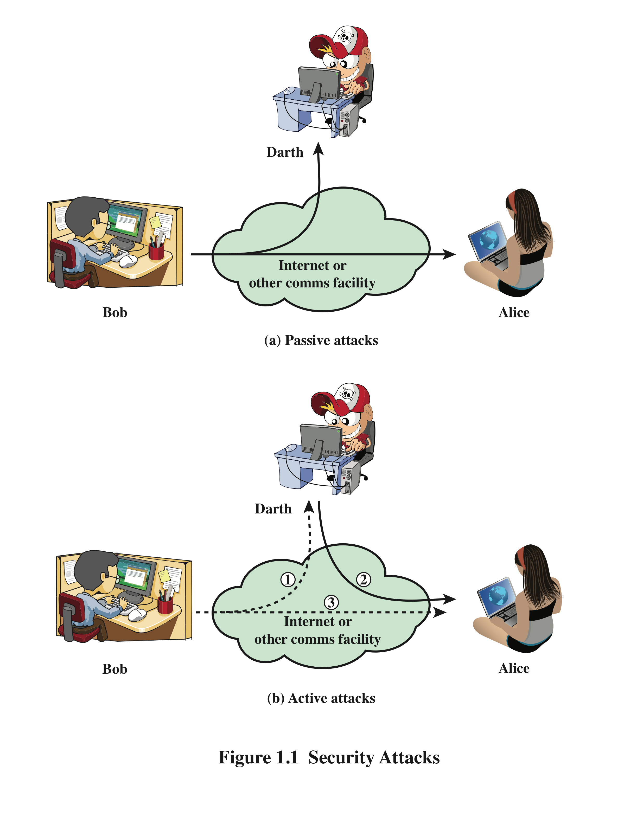
Security Attacks

Slide 15
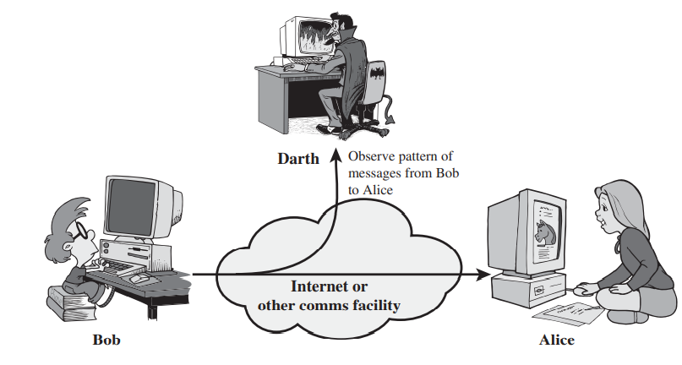
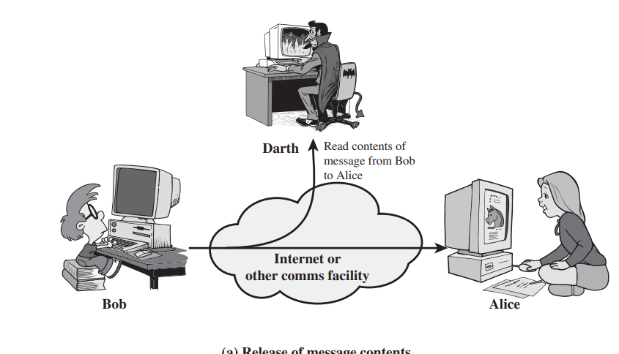
Security Attacks-Passive

Slide 16
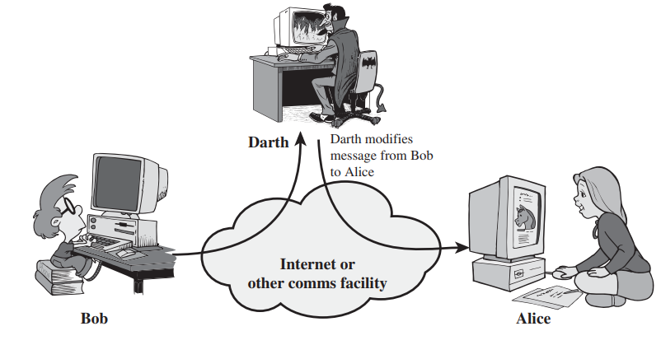
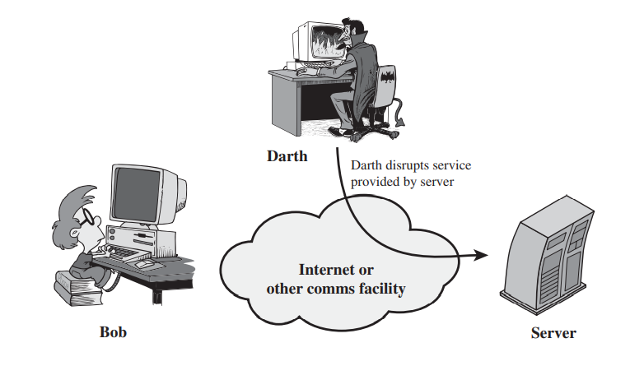
Security Attacks-Active

Slide 17
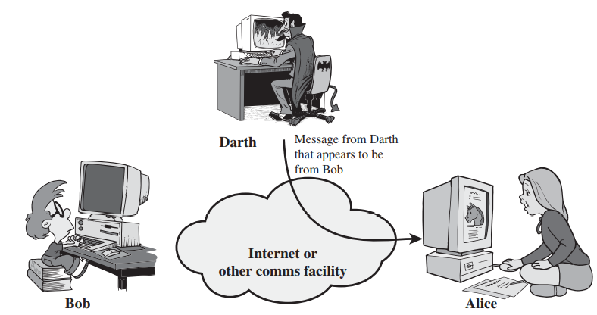
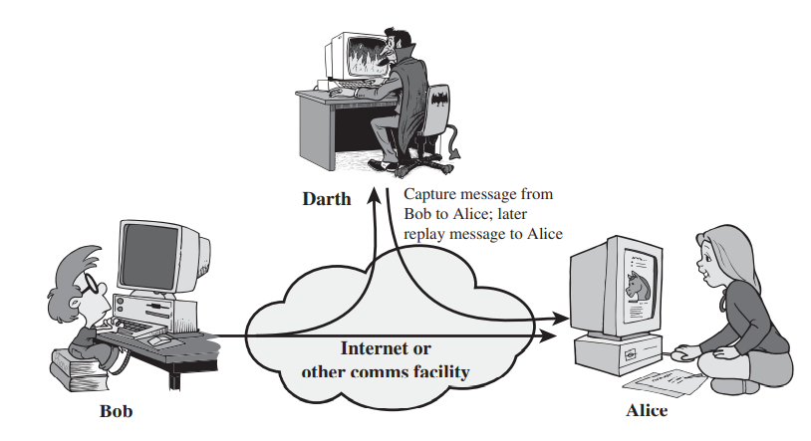
Security Attacks

Slide 18
Security Attacks-Active
Masquerade
Takes place when one entity pretends to be a different entity
Usually includes one of the other forms of active attack
Replay
Involves the passive capture of a data unit and its subsequent retransmission to produce an unauthorized effect
Modification of messages
Some portion of a legitimate message is altered, or messages are delayed or reordered to produce an unauthorized effect
Denial of service
Prevents or inhibits the normal use or management of communications facilities

Slide 19
Security Services
Defined by X.800 as:
A service provided by a protocol layer of communicating open systems and that ensures adequate security of the systems or of data transfers
Defined by RFC 4949 as:
A processing or communication service provided by a system to give a specific kind of protection to system resources

Slide 20
X.800 Service Categories
Authentication
Access control
Data confidentiality
Data integrity
Nonrepudiation

Slide 21
Authentication
Concerned with assuring that a communication is authentic
In the case of a single message, assures the recipient that the message is from the source that it claims to be from
In the case of ongoing interaction, assures the two entities are authentic and that the connection is not interfered with in such a way that a third party can masquerade as one of the two legitimate parties
Two specific authentication services are defined in X.800:
Peer entity authentication
Data origin authentication

Slide 22
X.800 Service Categories-Access Control
The ability to limit and control the access to host systems and applications via communications links
To achieve this, each entity trying to gain access must first be identified, or authenticated, so that access rights can be tailored to the individual

Slide 23
X.800 Service Categories-Data Confidentiality
The protection of transmitted data from passive attacks
Broadest service protects all user data transmitted between two users over a period of time
Narrower forms of service includes the protection of a single message or even specific fields within a message
The protection of traffic flow from analysis
This requires that an attacker not be able to observe the source and destination, frequency, length, or other characteristics of the traffic on a communications facility

Slide 24
X.800 Service Categories-Data Integrity
Can apply to a stream of messages, a single message, or selected fields within a message
Connection-oriented integrity service, one that deals with a stream of messages, assures that messages are received as sent with no duplication, insertion, modification, reordering, or replays
A connectionless integrity service, one that deals with individual messages without regard to any larger context, generally provides protection against message modification only

Slide 25
X.800 Service Categories-Nonrepudiation
Prevents either sender or receiver from denying a transmitted message
When a message is sent, the receiver can prove that the alleged sender in fact sent the message
When a message is received, the sender can prove that the alleged receiver in fact received the message

Slide 26
Security Mechanisms
Specific Security Mechanisms
Encipherment
Digital signatures
Access controls
Data integrity
Authentication exchange
Traffic padding
Routing control
Notarization

Slide 27
Security Mechanisms
Pervasive Security Mechanisms
Trusted functionality
Security labels
Event detection
Security audit trails
Security recovery

Slide 28
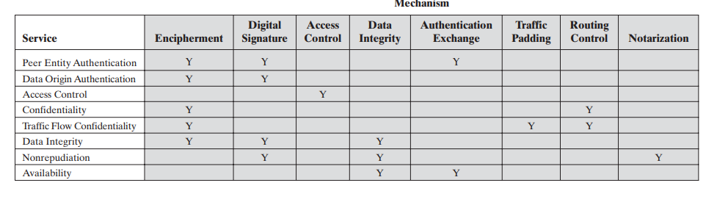
Relationship Between security Services &Mechanisms

Slide 29
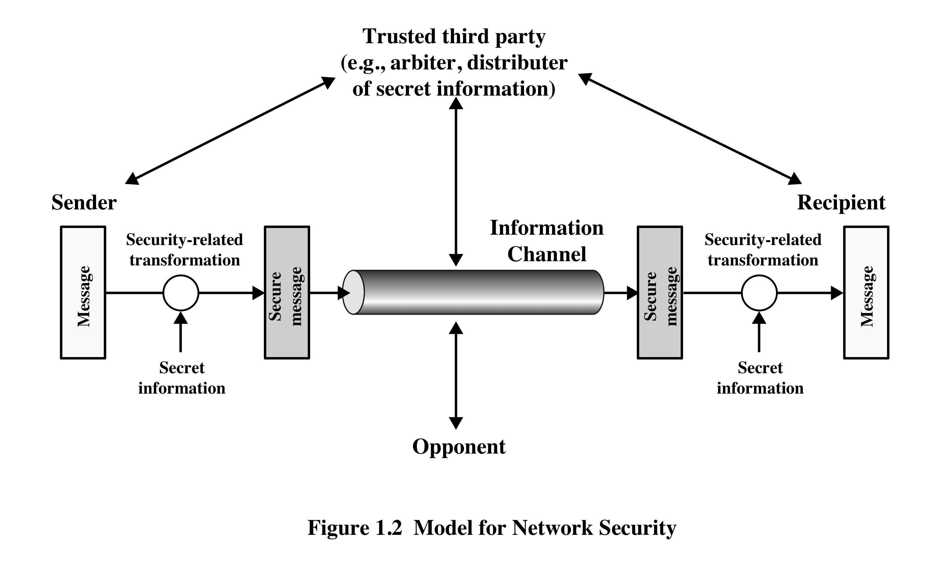
Model For Network Security

Slide 30
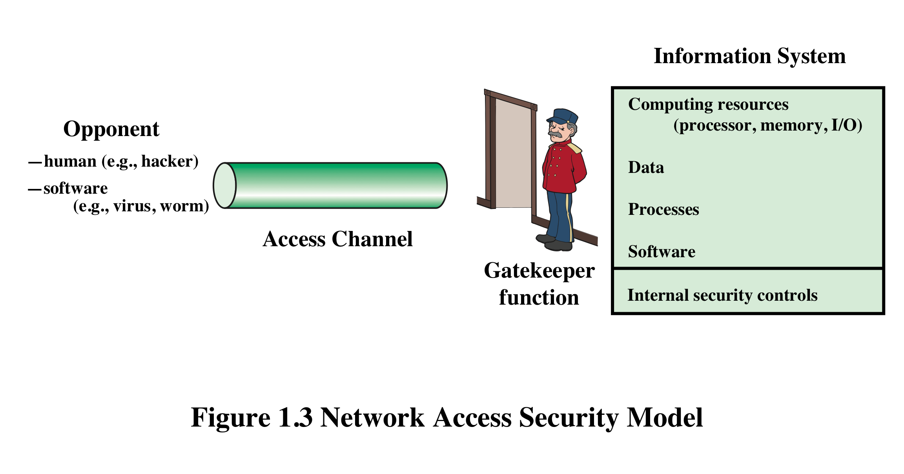
Network Access Security Model

Slide 31
Unwanted Access
Placement in a computer system of logic that exploits vulnerabilities in the system and that can affect application programs as well as utility programs such as editors and compilers
Programs can present two kinds of threats:
Information access threats
Intercept or modify data on behalf of users who should not have access to that data
Service threats
Exploit service flaws in computers to inhibit use by legitimate users

Slide 32
Symmetric Encryption
Also referred to as conventional encryption or single-key encryption
Was the only type of encryption in use prior to the development of public-key encryption in the 1970s
Remains by far the most widely used of the two types of encryption

Slide 33
Basic Terminologies
Plaintext
The original message
Ciphertext
The coded message
Enciphering or encryption
Process of converting from plaintext to ciphertext
Deciphering or decryption
Restoring the plaintext from the ciphertext
Cryptography
Study of encryption

Slide 34
Basic Terminologies
Cryptographic system or cipher
Schemes used for encryption
Cryptanalysis
Techniques used for deciphering a message without any knowledge of the enciphering details
Cryptology
Areas of cryptography and cryptanalysis together

Slide 35
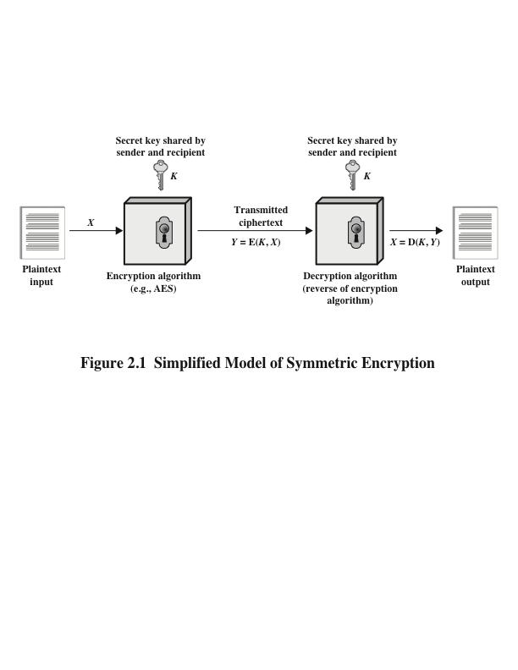
Simplified Model of Symmetric Encryption

Slide 36
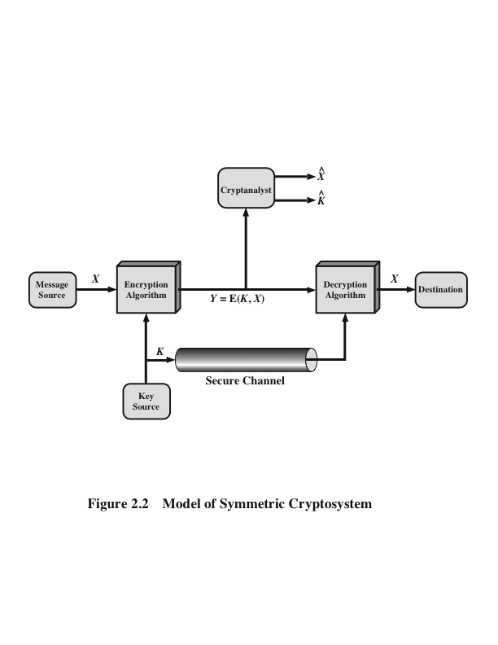
Model of Symmetric Cryptosystem

Slide 37
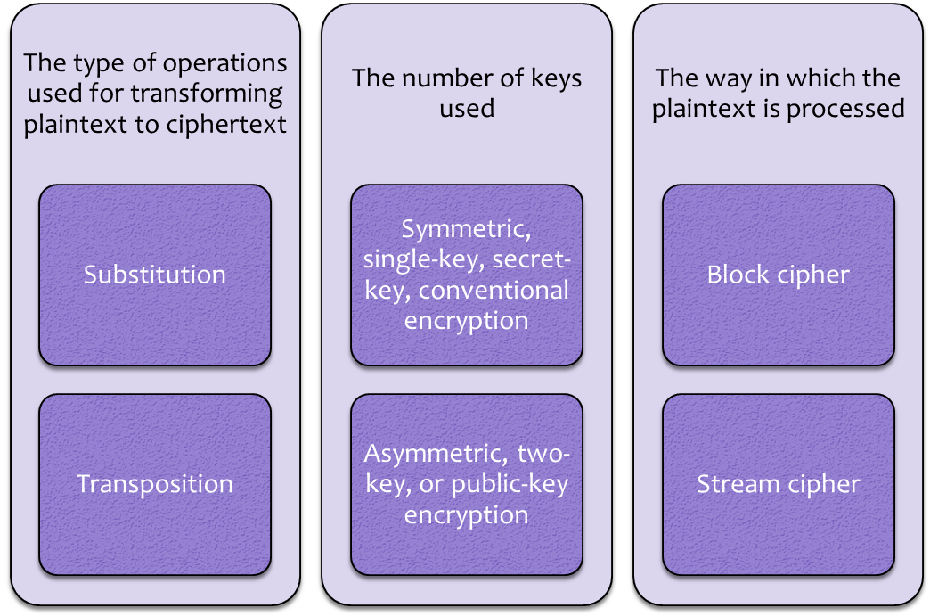
Cryptographic Systems

Slide 38
Cryptanalysis and Brute-Force Attack
Cryptanalysis
Attack relies on the nature of the algorithm plus some knowledge of the general characteristics of the plaintext
Attack exploits the characteristics of the algorithm to attempt to deduce a specific plaintext or to deduce the key being used
Brute-force attack
Attacker tries every possible key on a piece of ciphertext until an intelligible translation into plaintext is obtained
On average, half of all possible keys must be tried to achieve success

Slide 39
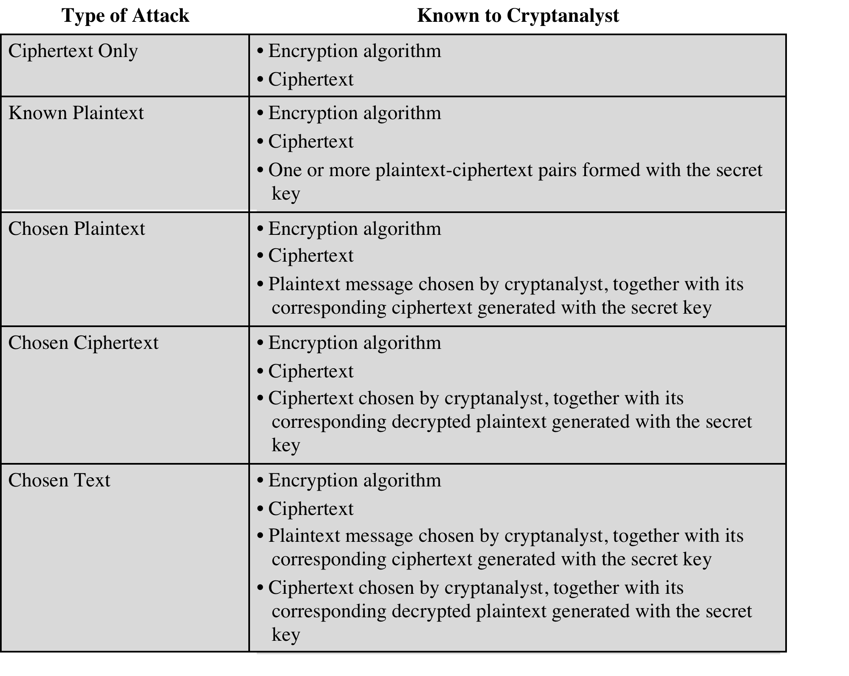

Slide 40
Encryption Scheme Security
Unconditionally secure
No matter how much time an opponent has, it is impossible for him or her to decrypt the ciphertext simply because the required information is not there
Computationally secure
The cost of breaking the cipher exceeds the value of the encrypted information
The time required to break the cipher exceeds the useful lifetime of the information

Slide 41
BRUTE -FORCE ATTACK
Involves trying every possible key until an intelligible translation of the ciphertext into plaintext is obtained
On average, half of all possible keys must be tried to achieve success
To supplement the brute-force approach, some degree of knowledge about the expected plaintext is needed, and some means of automatically distinguishing plaintext from garble is also needed

Slide 42
Substitution Techniques
Is one in which the letters of plaintext are replaced by other letters or by numbers or symbols
If the plaintext is viewed as a sequence of bits, then substitution involves replacing plaintext bit patterns with ciphertext bit patterns

Slide 43
CAESAR CIPHER
Simplest and earliest known use of a substitution cipher
Used by Julius Caesar
Involves replacing each letter of the alphabet with the letter standing three places further down the alphabet
Alphabet is wrapped around so that the letter following Z is A
plain: meet me after the toga party
cipher: PHHW PH DIWHU WKH WRJD SDUWB

Slide 44
Caesar Cipher-Algorithm
Can define transformation as:
a b c d e f g h i j k l m n o p q r s t u v w x y z
D E F G H I J K L M N O P Q R S T U V W X Y Z A B C
Mathematically give each letter a number
a b c d e f g h i j k l m n o p q r s t u v w x y z
0 1 2 3 4 5 6 7 8 9 10 11 12 13 14 15 16 17 18 19 20 21 22 23 24 25
Algorithm can be expressed as:
c = E(3, p) = (p + 3) mod (26)
A shift may be of any amount, so that the general Caesar algorithm is:
C = E(k , p ) = (p + k ) mod 26
Where k takes on a value in the range 1 to 25; the decryption algorithm is simply:
p = D(k , C ) = (C - k ) mod 26

Slide 45
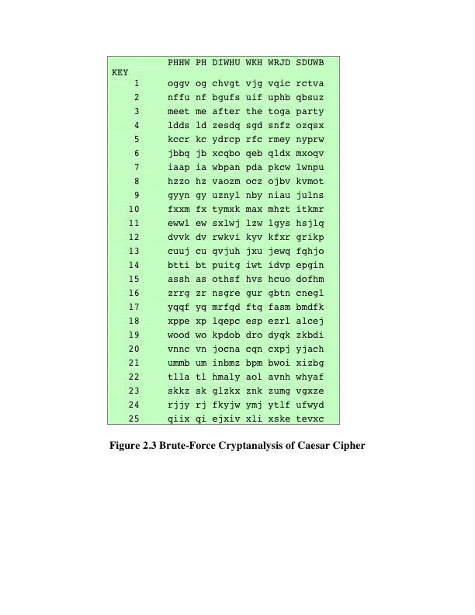
Brute-Force Cryptanalysis-Caesar Cipher

Slide 46
Monoalphabetic Cipher
Permutation
Of a finite set of elements S is an ordered sequence of all the elements of S , with each element appearing exactly once
If the “cipher” line can be any permutation of the 26 alphabetic characters, then there are 26! or greater than 4 x 10²⁶ possible keys
This is 10 orders of magnitude greater than the key space for DES
Approach is referred to as a monoalphabetic substitution cipher because a single cipher alphabet is used per message

Slide 47
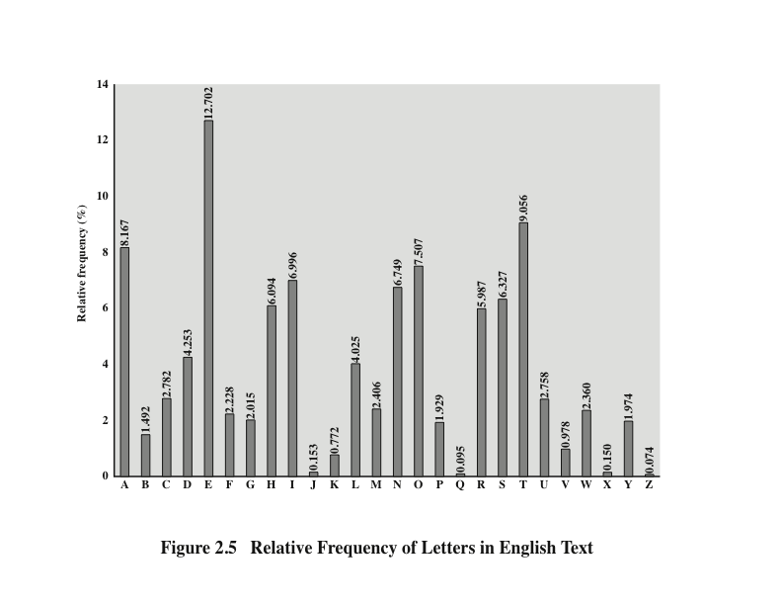
Monoalphabetic Cipher

Slide 48
Monoalphabetic Cipher
Easy to break because they reflect the frequency data of the original alphabet
Countermeasure is to provide multiple substitutes (homophones) for a single letter
Digram
Two-letter combination
Most common is th
Trigram
Three-letter combination
Most frequent is the

Slide 49
Playfair Cipher
Best-known multiple-letter encryption cipher
Treats digrams in the plaintext as single units and translates these units into ciphertext digrams
Based on the use of a 5 x 5 matrix of letters constructed using a keyword
Invented by British scientist Sir Charles Wheatstone in 1854
Used as the standard field system by the British Army in World War I and the U.S. Army and other Allied forces during World War II

Slide 50
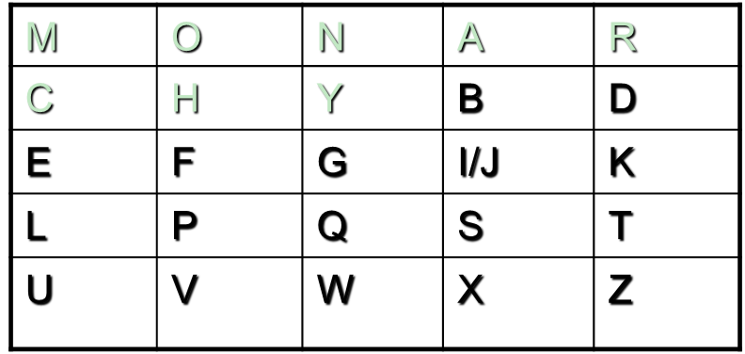
Playfair Cipher
Fill in letters of keyword (minus duplicates) from left to right and from top to bottom, then fill in the remainder of the matrix with the remaining letters in alphabetic order
Using the keyword MONARCHY:

Slide 51
Playfair Cipher
1.Repeating plaintext letters that are in the same pair are separated with a filler letter, such as x, so that balloon would be treated as ba lx lo on.
2. Two plaintext letters that fall in the same row of the matrix are each replaced by the letter to the right, with the first element of the row circularly following the last. For example, ar is encrypted as RM.
3. Two plaintext letters that fall in the same column are each replaced by the letter beneath, with the top element of the column circularly following the last. For example, mu is encrypted as CM.
4. Otherwise, each plaintext letter in a pair is replaced by the letter that lies in its own row and the column occupied by the other plaintext letter. Thus, hs becomes BP and ea becomes IM (or JM, as the encipherer wishes).

Slide 52
Hill Cipher
Developed by the mathematician Lester Hill in 1929
Strength is that it completely hides single-letter frequencies
The use of a larger matrix hides more frequency information
A 3 x 3 Hill cipher hides not only single-letter but also two-letter frequency information
Strong against a ciphertext-only attack but easily broken with a known plaintext attack

Slide 53
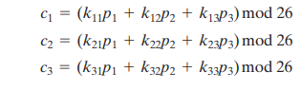
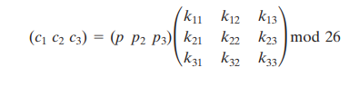
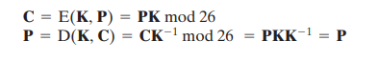
Hill Cipher
C = PK mod 26

Slide 54
Polyalphabetic Cipher
Polyalphabetic substitution cipher
Improves on the simple monoalphabetic technique by using different monoalphabetic substitutions as one proceeds through the plaintext message
All these techniques have the following features in common:
A set of related monoalphabetic substitution rules is used
A key determines which particular rule is chosen for a given transformation

Slide 55
Transposition Techniques
A very different kind of mapping is achieved by performing some sort of permutation on the plaintext letters.
This technique is referred to as a transposition cipher
Example:
Rail Fence Cipher

Slide 56
Rail Fence Cipher
Simplest transposition cipher
Plaintext is written down as a sequence of diagonals and then read off as a sequence of rows
To encipher the message “meet me after the toga party” with a rail fence of depth 2, we would write:
m e m a t r h t g p r y
e t e f e t e o a a t
Encrypted message is:
MEMATRHTGPRYETEFETEOAAT

Slide 57
Row Transposition Cipher
Is a more complex transposition
Write the message in a rectangle, row by row, and read the message off, column by column, but permute the order of the columns
The order of the columns then becomes the key to the algorithm
Key: 4 3 1 2 5 6 7
Plaintext: a t t a c k p
o s t p o n e
d u n t i l t
w o a mx y z
Ciphertext: TTNAAPTMTSUOAODWCOIXKNLYPETZ

Slide 58
Stream Cipher
Encrypts a digital data stream one bit or one byte at a time
Examples:
Autokeyed Vigenère cipher
Vernam cipher
In the ideal case a one-time pad version of the Vernam cipher would be used, in which the keystream is as long as the plaintext bit stream
If the cryptographic keystream is random, then this cipher is unbreakable by any means other than acquiring the keystream
Keystream must be provided to both users in advance via some independent and secure channel
This introduces insurmountable logistical problems if the intended data traffic is very large
For practical reasons the bit-stream generator must be implemented as an algorithmic procedure so that the cryptographic bit stream can be produced by both users
It must be computationally impractical to predict future portions of the bit stream based on previous portions of the bit stream
The two users need only share the generating key and each can produce the keystream
Notes:
A stream cipher is one that encrypts a digital data stream one bit or one byte at
a time. Examples of classical stream ciphers are the autokeyed Vigenère cipher
and the Vernam cipher. In the ideal case, a one-time pad version of the Vernam
cipher would be used (Figure 2.7), in which the keystream (ki ) is as long as the
plaintext bit stream (pi ). If the cryptographic keystream is random, then this cipher
is unbreakable by any means other than acquiring the keystream. However, the
keystream must be provided to both users in advance via some independent and
secure channel. This introduces insurmountable logistical problems if the intended
data traffic is very large.
Accordingly, for practical reasons, the bit-stream generator must be
implemented as an algorithmic procedure, so that the cryptographic bit stream
can be produced by both users. In this approach (Figure 3.1a), the bit-stream
generator is a key-controlled algorithm and must produce a bit stream that is
cryptographically strong. That is, it must be computationally impractical to
predict future portions of the bit stream based on previous portions of the bit
stream. The two users need only share the generating key, and each can produce
the keystream.

Slide 59
Block Cipher Principles
A block of plaintext is treated as a whole and used to produce a ciphertext block of equal length
Typically a block size of 64 or 128 bits is used
As with a stream cipher, the two users share a symmetric encryption key
The majority of network-based symmetric cryptographic applications make use of block ciphers

Slide 60
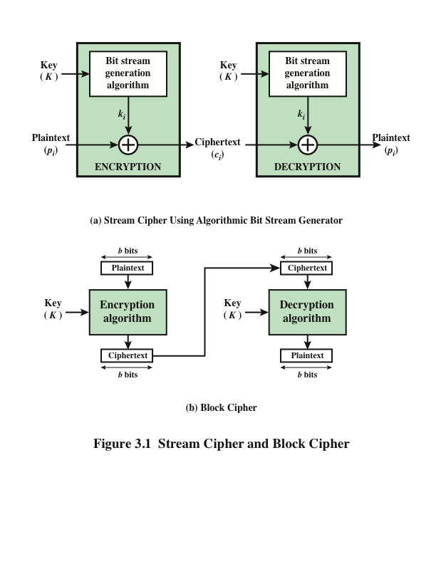
Block Cipher Principles

Slide 61
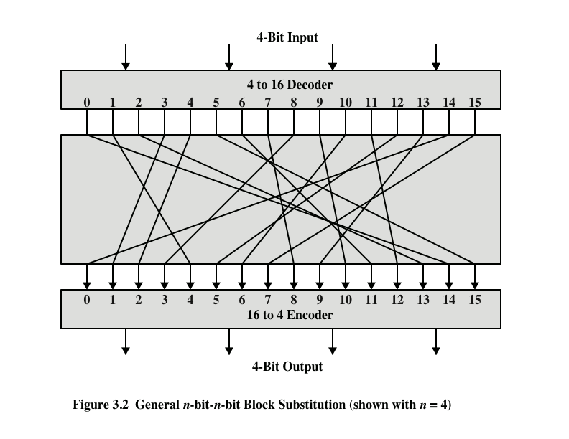
Block Cipher Principles

Slide 62
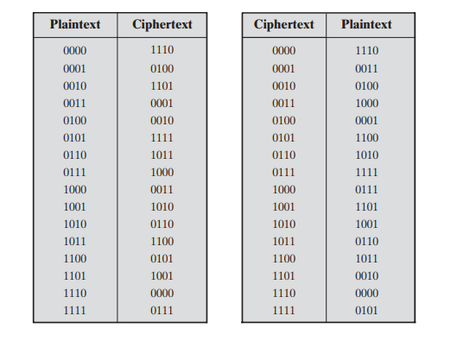
Block Cipher Principles

Slide 63
Feistel Cipher
Proposed the use of a cipher that alternates substitutions and permutations
Is a practical application of a proposal by Claude Shannon to develop a product cipher that alternates confusion and diffusion functions
Is the structure used by many significant symmetric block ciphers currently in use
Substitutions
Each plaintext element or group of elements is uniquely replaced by a corresponding ciphertext element or group of elements
Permutation
No elements are added or deleted or replaced in the sequence, rather the order in which the elements appear in the sequence is changed
Notes:
Feistel proposed [FEIS73] that we can approximate the ideal block cipher by utilizing
the concept of a product cipher, which is the execution of two or more simple ciphers
in sequence in such a way that the final result or product is cryptographically stronger
than any of the component ciphers. The essence of the approach is to develop a block
cipher with a key length of k bits and a block length of n bits, allowing a total of 2^{k}
possible transformations, rather than the 2^{n} ! transformations available with the ideal
block cipher.
In particular, Feistel proposed the use of a cipher that alternates substitutions
and permutations, where these terms are defined as follows:
• Substitution: Each plaintext element or group of elements is uniquely replaced
by a corresponding ciphertext element or group of elements.
• Permutation: A sequence of plaintext elements is replaced by a permutation
of that sequence. That is, no elements are added or deleted or replaced in the
sequence, rather the order in which the elements appear in the sequence is
changed.
In fact, Feistel’s is a practical application of a proposal by Claude Shannon
to develop a product cipher that alternates confusion and diffusion functions
[SHAN49]. We look next at these concepts of diffusion and confusion and then
present the Feistel cipher. But first, it is worth commenting on this remarkable fact:
The Feistel cipher structure, which dates back over a quarter century and which, in
turn, is based on Shannon’s proposal of 1945, is the structure used by many significant
symmetric block ciphers currently in use.

Slide 64
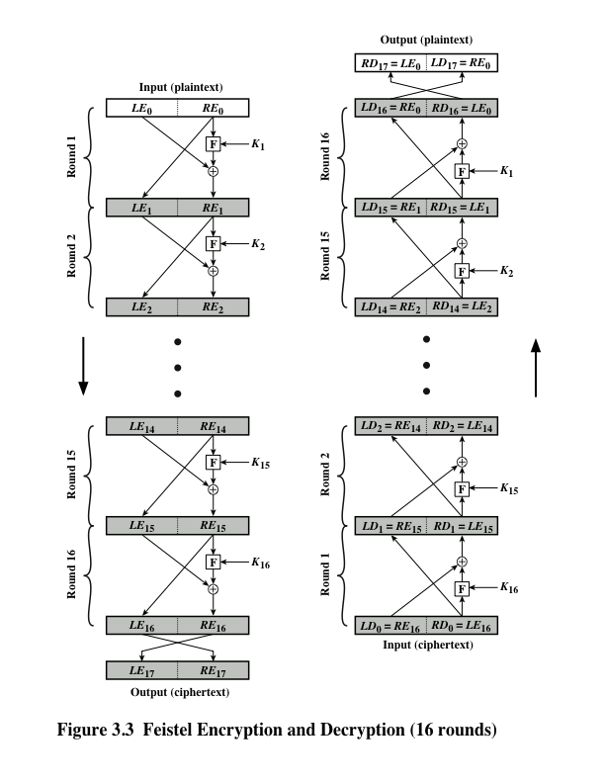
Fiestal Structure

Slide 65
Feistel Cipher Design Features
Block size
Larger block sizes mean greater security but reduced encryption/decryption speed for a given algorithm
Key size
Larger key size means greater security but may decrease encryption/decryption speeds
Number of rounds
The essence of the Feistel cipher is that a single round offers inadequate security but that multiple rounds offer increasing security
Subkey generation algorithm
Greater complexity in this algorithm should lead to greater difficulty of cryptanalysis
Round function F
Greater complexity generally means greater resistance to cryptanalysis
Fast software encryption/decryption
In many cases, encrypting is embedded in applications or utility functions in such a way as to preclude a hardware implementation; accordingly, the speed of execution of the algorithm becomes a concern
Ease of analysis
If the algorithm can be concisely and clearly explained, it is easier to analyze that algorithm for cryptanalytic vulnerabilities and therefore develop a higher level of assurance as to its strength
Notes:
The exact realization of a Feistel network depends on the choice of the following
parameters and design features:
• Block size: Larger block sizes mean greater security (all other things being
equal) but reduced encryption/decryption speed for a given algorithm. The
greater security is achieved by greater diffusion. Traditionally, a block size of
64 bits has been considered a reasonable tradeoff and was nearly universal in
block cipher design. However, the new AES uses a 128-bit block size.
• Key size: Larger key size means greater security but may decrease encryption/
decryption speed. The greater security is achieved by greater resistance to
brute-force attacks and greater confusion. Key sizes of 64 bits or less are now
widely considered to be inadequate, and 128 bits has become a common size.
• Number of rounds: The essence of the Feistel cipher is that a single round
offers inadequate security but that multiple rounds offer increasing security.
A typical size is 16 rounds.
• Subkey generation algorithm: Greater complexity in this algorithm should
lead to greater difficulty of cryptanalysis.
• Round function F: Again, greater complexity generally means greater resistance
to cryptanalysis.
There are two other considerations in the design of a Feistel cipher:
• Fast software encryption/decryption: In many cases, encryption is embedded in
applications or utility functions in such a way as to preclude a hardware implementation.
Accordingly, the speed of execution of the algorithm becomes a
concern.
• Ease of analysis: Although we would like to make our algorithm as difficult as
possible to cryptanalyze, there is great benefit in making the algorithm easy to
analyze. That is, if the algorithm can be concisely and clearly explained, it is
easier to analyze that algorithm for cryptanalytic vulnerabilities and therefore
develop a higher level of assurance as to its strength. DES, for example, does
not have an easily analyzed functionality.

Slide 66


Slide 67
The End

